Slide 2
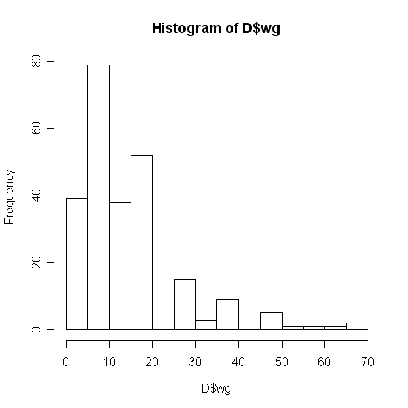
Basic Graphics
Histogram
hist(D$wg)

Slide 3
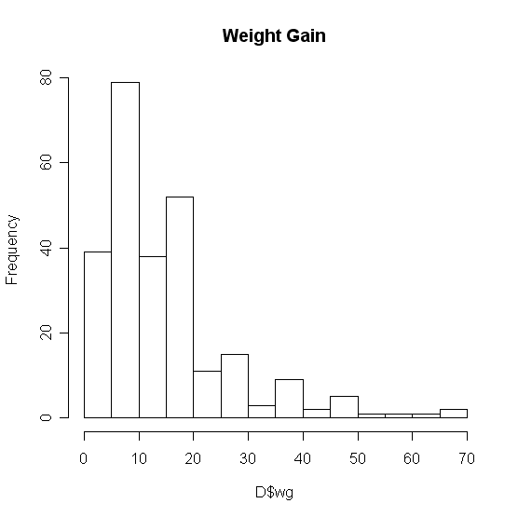
Basic Graphics
Add a title…
The “main” statement will give the plot an overall heading.
hist(D$wg , main=‘Weight Gain’)

Slide 4
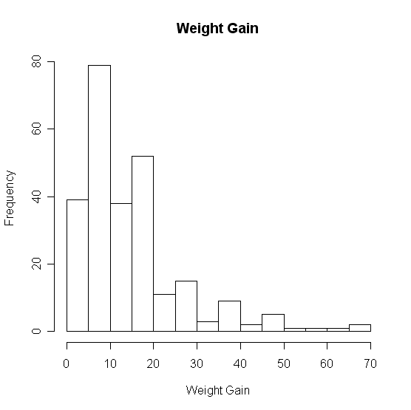
Basic Graphics
Adding axis labels…
Use “xlab” and “ylab” to label the X and Y axes, respectively.
hist(D$wg , main=‘Weight Gain’,xlab=‘Weight Gain’, ylab =‘Frequency’)

Slide 5
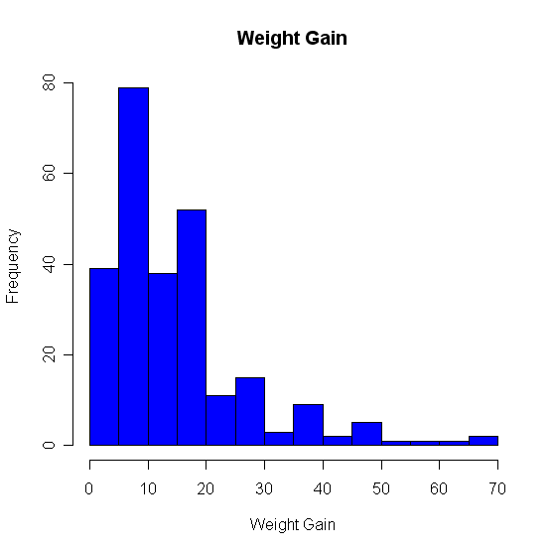
Basic Graphics
Changing colors…
Use the col statement.
?colors will give you help on the colors.
Common colors may simply put in using the name.
hist(D$wg, main=“Weight Gain”,xlab=“Weight Gain”, ylab =“Frequency”, col=“blue”)

Slide 6
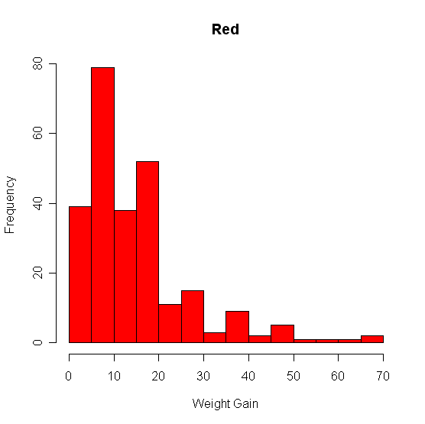
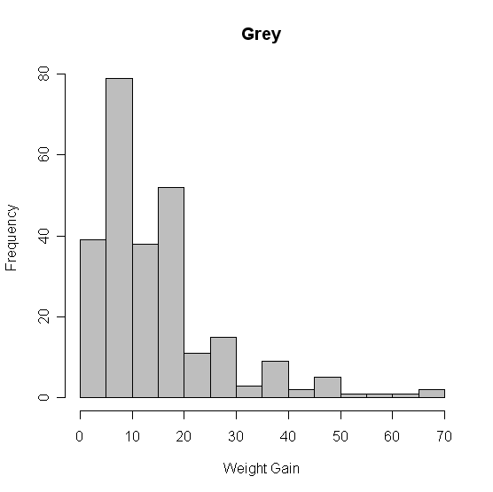
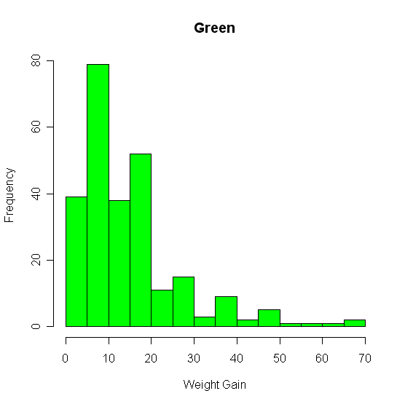
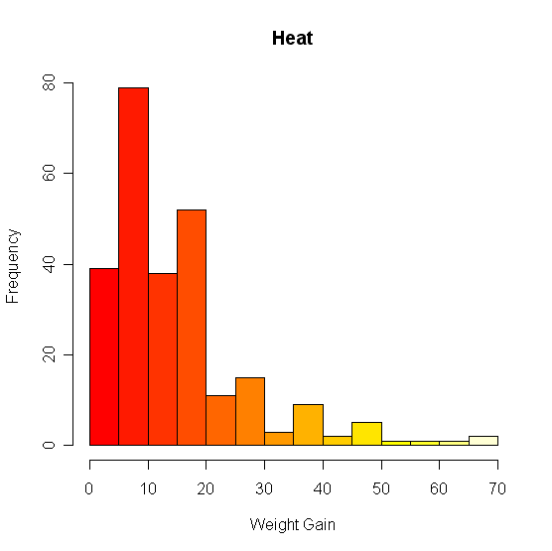
Basic Graphics – Colors

Slide 7
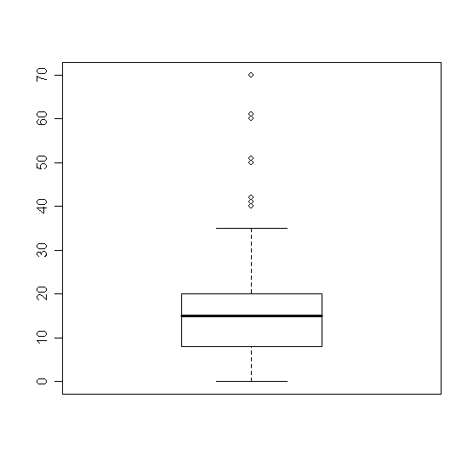
Basic Plots
Box Plots
boxplot(D$wg)

Slide 8
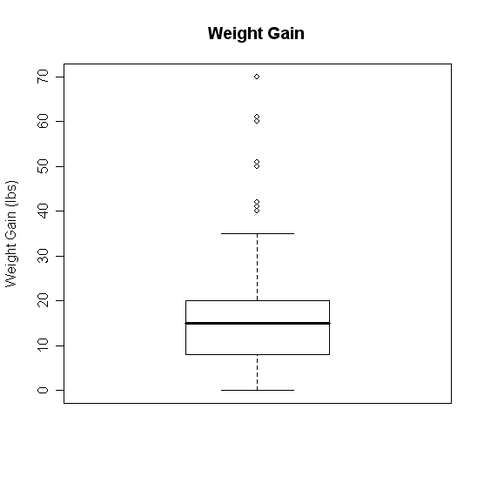
Boxplots
Change it!
boxplot(D$wg,main='Weight Gain',ylab='Weight Gain (lbs)')

Slide 9
Box-Plots - Groupings
What if we want several box plots side by side to be able to compare them.
First Subset the Data into separate variables.
wg.m <- D[D$Gender=="M",]
wg.f <- D[D$Gender=="F",]
Then Create the box plot.
boxplot(wg.m$wg,wg.f$wg)

Slide 10
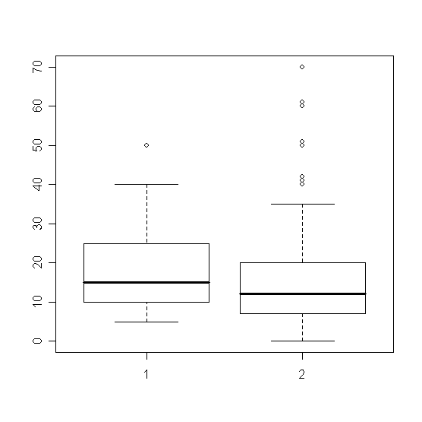
Boxplots – Groupings

Slide 11
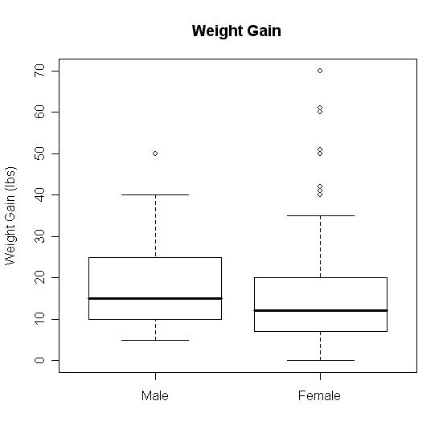
Boxplots - Groupings
boxplot(wg.m$wg, wg.f$wg, main='Weight Gain (lbs)', ylab='Weight Gain', names = c('Male','Female'))

Slide 12
Boxplot Groupings
Do it by shift
wg.7a <- D[D$Shift=="7am",]
wg.8a <- D[D$Shift=="8am",]
wg.9a <- D[D$Shift=="9am",]
wg.10a <- D[D$Shift=="10am",]
wg.11a <- D[D$Shift=="11am",]
wg.12p <- D[D$Shift=="12pm",]
boxplot(wg.7a$wg, wg.8a$wg, wg.9a$wg, wg.10a$wg, wg.11a$wg, wg.12p$wg, main='Weight Gain', ylab='Weight Gain (lbs)', xlab='Shift', names = c('7am','8am','9am','10am','11am','12pm'))

Slide 13
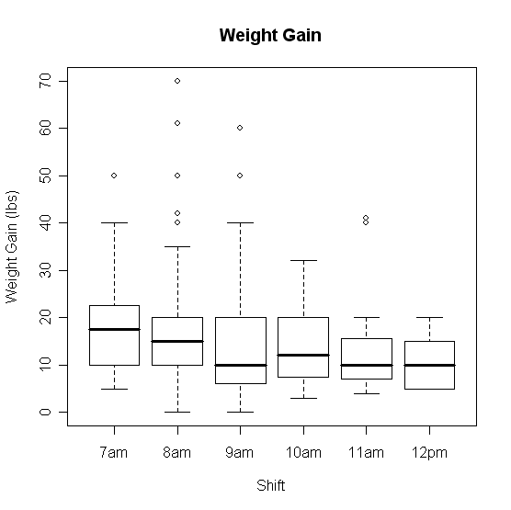
Boxplots Groupings

Slide 14
Scatter Plots
Suppose we have two variables and we wish to see the relationship between them.
A scatter plot works very well.
R code:
plot(x,y)
Example
plot(D$metmin,D$wg)

Slide 15
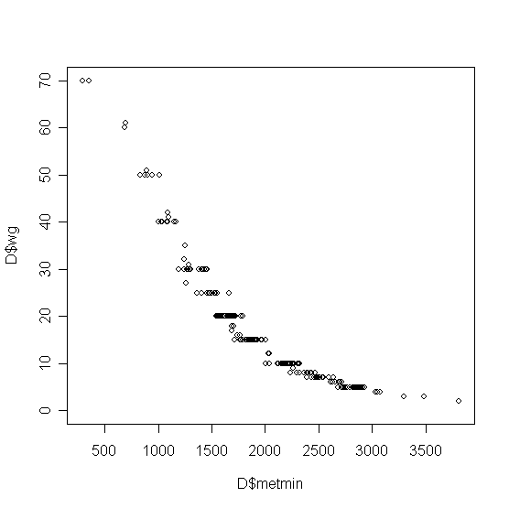
Scatterplots

Slide 16
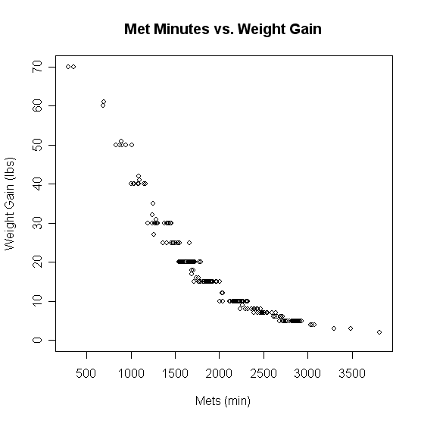
Scatterplots
plot(D$metmin,D$wg,main='Met Minutes vs. Weight Gain',
xlab='Mets (min)',ylab='Weight Gain (lbs)')

Slide 17
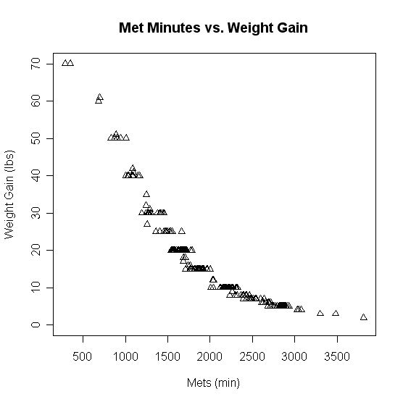
Scatterplots
plot(D$metmin,D$wg,main='Met Minutes vs. Weight Gain',
xlab='Mets (min)',ylab='Weight Gain (lbs)',pch=2)

Slide 18
Line Plots
Often data comes through time.
Consider Dell stock
D2 <- read.csv("H:\\Dell.csv",header=TRUE)
t1 <- 1:nrow(D2)
plot(t1,D2$DELL)

Slide 19
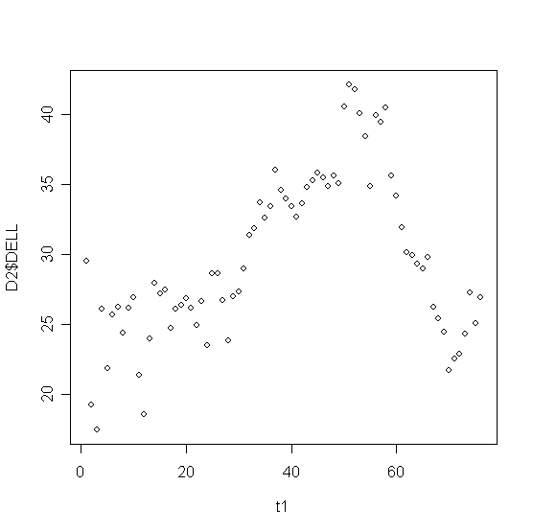
Line Plots

Slide 20
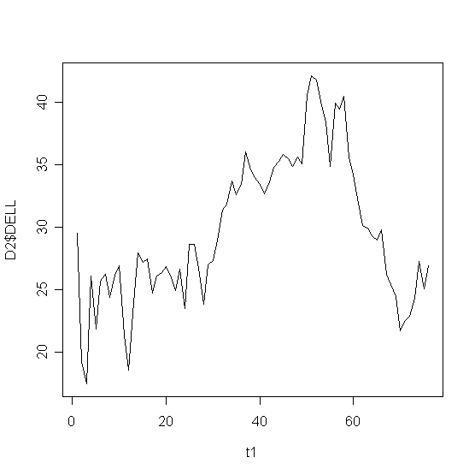
Line Plots
plot(t1,D2$DELL,type="l")

Slide 21
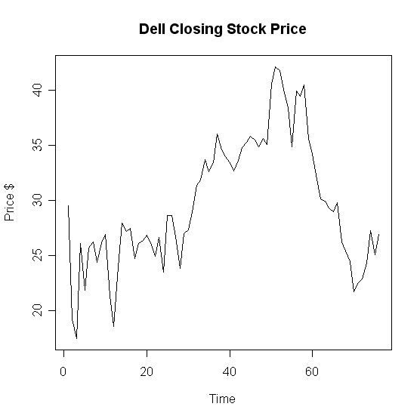
Line Plots
plot(t1,D2$DELL,type="l",main='Dell Closing Stock Price',
xlab='Time',ylab='Price $'))

Slide 22
Overlaying Plots
Often we have more than one variable measured against the same predictor (X).
plot(t1,D2$DELL,type="l",main='Dell Closing Stock Price',xlab='Time',ylab='Price $'))
lines(t1,D2$Intel)

Slide 23
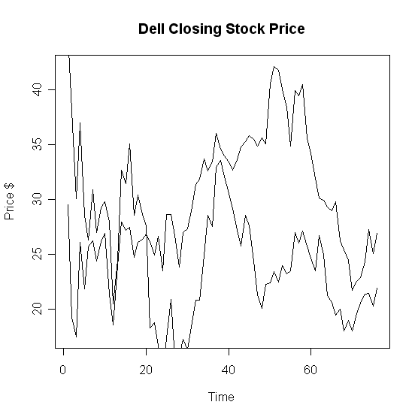
Overlaying Graphs

Slide 24
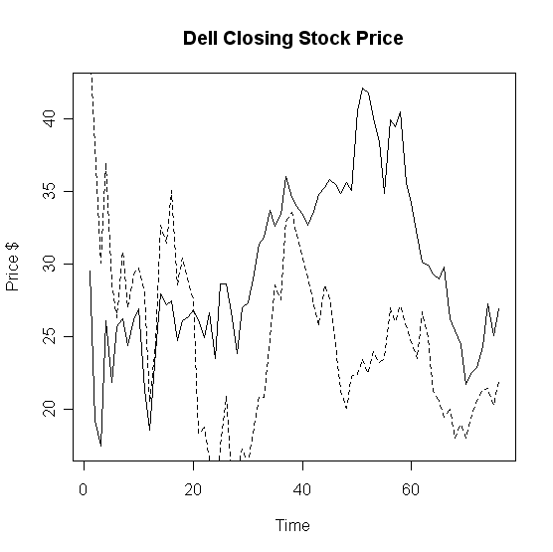
Overlaying Graphs
lines(t1,D2$Intel,lty=2)

Slide 25
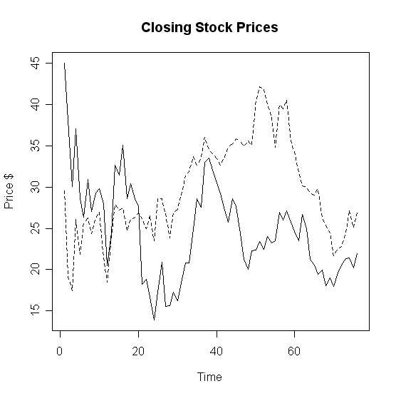
Overlaying Graphs

Slide 26
Adding a Legend
Adding a legend is a bit tricky in R.
Syntax
legend( x, y, names, line types)
X
coordinate
Y
coordinate
Names of series in column format
Corresponding line types

Slide 27
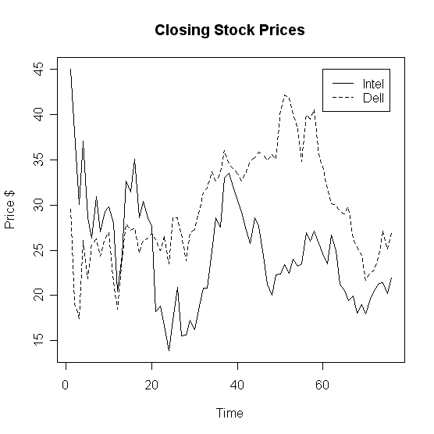
Adding a Legend
legend(60,45,c('Intel','Dell'),lty=c(1,2))

Slide 28
Paneling Graphics
Suppose we want more than one graphic on a panel.
We can partition the graphics panel to give us a framework in which to panel our plots.
par(mfrow = c( nrow, ncol))
Number of rows
Number of columns

Slide 29
Paneling Graphics
Consider the following
par(mfrow=c(2,2))
hist(D$wg, main='Histogram',xlab='Weight Gain', ylab ='Frequency', col=heat.colors(14))
boxplot(wg.7a$wg, wg.8a$wg, wg.9a$wg, wg.10a$wg, wg.11a$wg, wg.12p$wg, main='Weight Gain', ylab='Weight Gain (lbs)',
xlab='Shift', names = c('7am','8am','9am','10am','11am','12pm'))
plot(D$metmin,D$wg,main='Met Minutes vs. Weight Gain', xlab='Mets (min)',ylab='Weight Gain (lbs)',pch=2)
plot(t1,D2$Intel,type="l",main='Closing Stock Prices',xlab='Time',ylab='Price $')
lines(t1,D2$DELL,lty=2)

Slide 30
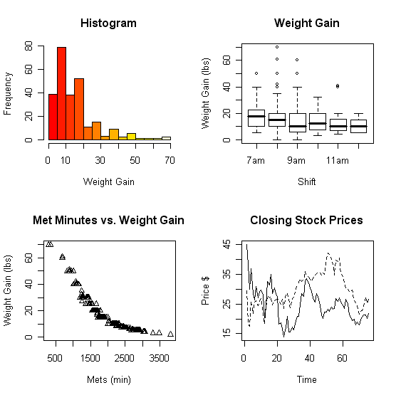
Paneling Graphics

Slide 31
Quality - Excel

Slide 32
Quality - R

Slide 33
Summary
All of the R code and files can be found at:
http://www.cran.r-project.org/

